Slide 1
DIABETES PREDICTION
Group X – Year 2 Recess Project

Slide 2
Concept Note
About the Pipeline?
This model is designed to predict the cases of diabetes based on provided medical
Health records.
Diabetes is a disease in which your blood glucose, or blood sugar levels are too high.
We used the dataset (kidney_disease.csv); published in 2015. It is properly structured having 400 rows and 25 real features.
Who are the Intended Users?
System admin ,
Normal Users (Student, Medical personnel)
Main Objective
Make accurate real-time diabetes predictions for patients.

Slide 3
Data Pipeline
1
Data Loading
2
Data Inspection
3
Visualization
Data cleaning
4
Model Implementation
Data Classification
5
Model Evaluation
6

Slide 4
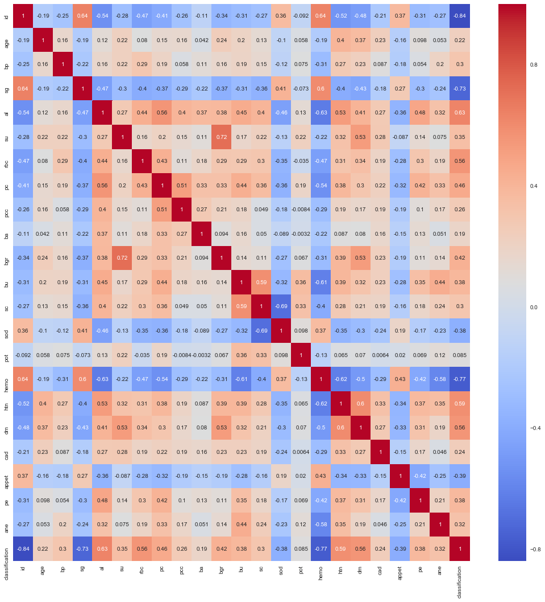
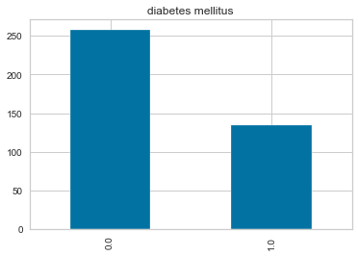
Visualizations
Feature Correlation Heat-map
Target Class Feature Comparison

Slide 5
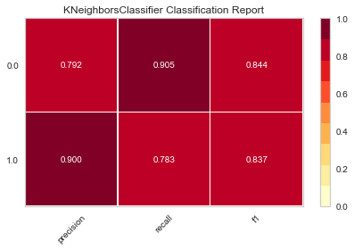
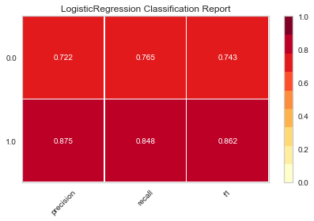
Model Selection
K-Nearest Neighbors Classifier
Logistic Regression

Slide 6
Conclusion
Recommendations
Add more observations (rows) to the dataset.
Increase the balance between the Classification features (dm) i.e. Ratio of (0.0:1.0).
Add more complete observations to the dataset having no null cells
Drop features that are irrelevant to the training of the model.

